Slide 1
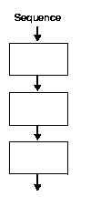

Sequential Flowchart and Pseudocode Design

Slide 2
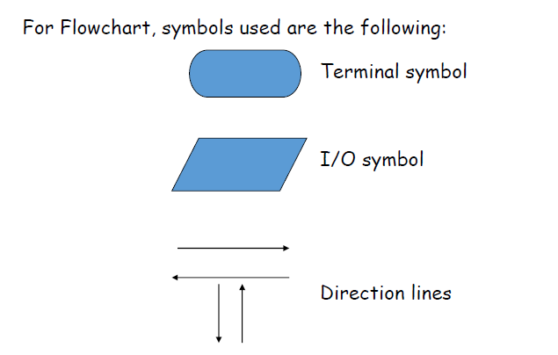

Slide 3
Pseudocode Syntax
Output:
Display “your string for prompt”
Display <var>
Display “your string”,<var>
Input:
Accept <var>
Accept <var1>,<var2>
Accept<var1>
Accept<var2>

Slide 4
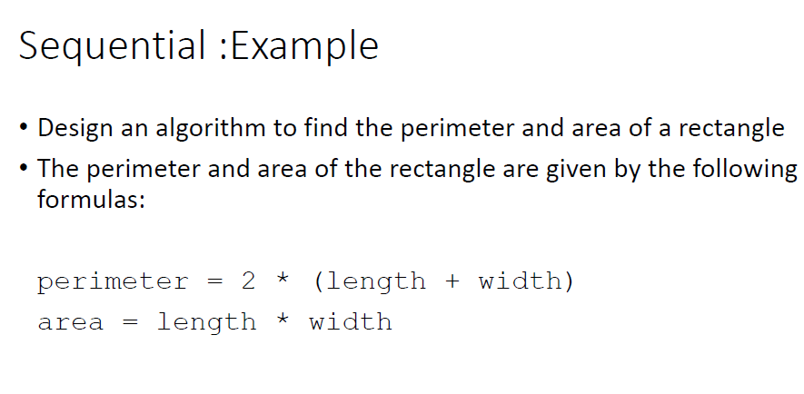

Slide 5
Sequential structure
Input a temperature in Celsius and output the corresponding temperature in Fahrenheit. The formula is a follows:
Fahrenheit = 9/5 (Celsius) + 32

Slide 6
Sequential structure
Pepperoni++ Pizza House charges 10% service charge and 5% sales tax on the gross bill of the customer. Create a flowchart and a pseudocode that would input the gross bill of the customer and the amount given by the customer to the waiter. It must output the customer’s total bill and change (if there’s any).

Slide 7
Sequential structure
Ten young men agreed to purchase a gift worth Php 10,000.00 for their idol: LA Lopez. In addition, they agreed to continue with their plan even if at least one of them drop out. Create a flowchart a pseudocode that would input the number of men who dropped out (assume 0 to 9 only) and output how much more will each have to contribute toward the purchase of the gift.

Slide 8
Sequential structure
Create a flowchart and a pseudocode that would input an integer number and then output its one’s digit or the right most digit.

Slide 9


